Slide 1
Welcome to the Industry Association Consortium Workshop on Technical Reviews
Acquisition reviews for discussion today:
SRR SFR PDR CDR
TRR SVR/FCA PRR PCA
Please find an available seat at a topic table you would like to discuss

Slide 2
NDIA DMM Workshop:
Please Go To The Table With The SETR Event You Would Like To Discuss
28 October 2024
Approved for public release

Slide 3
AGENDA
Time | Subject | Speaker
1330-1350 | Welcome and Admin | Lt Col Ryan Pospisal
1350-1400 | Tasking #1: What Are We Changing To? | Mr. Kyle Hurst
1400-1450 | Facilitated Breakout #1: Addressing Digital-based, Continuous Technical Reviews | -
1450-1455 | Breakout #1 Wrap Up/Admin | Lt Col Ryan Pospisal
1455-1510 | Break | -
1510-1520 | Tasking #2: Future State for Technical Reviews | Ms. Monika Patel-Parsons
1520-1615 | Facilitated Breakout #2: Imagining the Future of Technical Reviews | -
1615-1645 | Breakout #2 Out-briefs | 2 Minute Briefs
1645-1700 | Closing Comments | Lt Col Ryan Pospisal
Approved for public release

Slide 4
Admin Info
Facility
Restroom locations
Emergency exits
IAC Materials Location:
https://guide.dafdto.com/industry-association-consortium-sharing-site/
Approved for public release

Slide 5
Workshop Administration
How is output captured?
Breakout 1 Worksheets can be found at your tables
Breakout 2 Worksheets will be distributed to each table after the completion of Session 1
The facilitators are here to help assist with the exercise, answer questions, and assist in capturing outputs of the workshop
Unclassified discussions only: no IP, CUI, or classified!
Approved for public release

Slide 6
DMM Introduction
Approved for public release

Slide 7
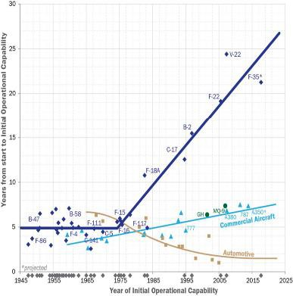
Strategic ‘Why”: Competing in Time
“it takes the US on average sixteen years to deliver an idea to operational capability, versus fewer than seven for China”
“Defense acquisition struggles to accommodate timely adoption of these emerging technologies”
“Competitive advantage in decision-centric operations (whether budgeting or on the battlefield) comes from the scale of available options, tempo of decision- making, and superior decision processes”
Average time to reach IOC by year
Source: Patt, W. G. (2021). Competing in Time: Ensuring Capability Advantage and Mission Success through Adaptable Resource Allocation
Digital Materiel Management (DMM) is HOW we revolutionize AFMC acquisition and sustainment processes
Approved for public release

Slide 8
Video OV-1
DMM: An Accelerated Future State Whitepaper
Ensure critical processes employ digital methods across the entire lifecycle
– from invention to retirement –
for both warfighting capabilities as well as installation and mission support capabilities
Approved for public release

Slide 9
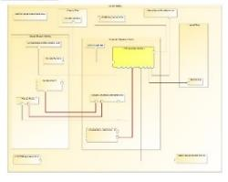
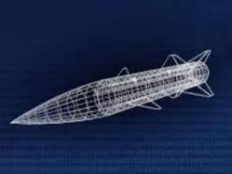
DMM Architecture
(CONTINUOUS PROCESS)
Gaps
Opportunities
HAF
AF FUTURES
MAJCOMS
Air Force Design
MBSE System Architecture
Required Capabilities
ENTERPRISE OPERATIONS ANALYSIS
Force Design & Wargaming
Experimentation Activities
S&T Requirements
Vanguards
Model-Based Capability Development Planning
Inform Contracting and
Architect in Modern Tools
Use Shared Digital Environment for Continuous Review
Data Driven Sustention to Optimize War-Winning Capabilities
Tradespace & Operations Analysis
Acquisition Planning
System Development
Sustainment & Logistics
ICC
ICD/CDD
AF Futures
TEO/iPEOs
IDO
AoA
RFP
SOW/PWS
CDRLS/DIDs
GRAs
Technical Reviews
Agile Development
Production
Test & Evaluation
Certifications
Supply
Maintenance
Operations
Product Support
Modifications
Guidance and Policy
Standards
Training
Tools
Data Architecture
DIGITAL ECOSYSTEM
PLM / Cloud / HPC / SAP-IT
Approved for public release

Slide 10
Premise – Open and non-attributional
This consortium provides a group of like-minded entities, that are experienced in a subject matter area, a means to collaborate within a set of guidelines to ensure progress.
By engaging through the IAC, participants are able to share in both problem articulation, and solution road-mapping/development, within the intersections of the DMM 6 Key Initiatives, the Lifecycle Functional Activities, and the Capability Delivery Process Activities.
IAC meetings are set as strategic venues-of-opportunity become available and are open to all current and potential participants
Approved for public release

Slide 11
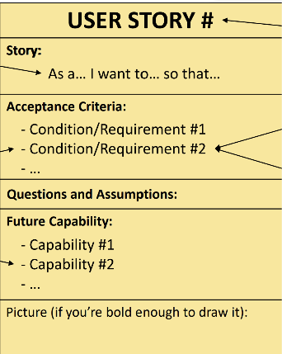
Where to Find Info about the IAC:
https://guide.dafdto.com - An Accelerated Future State
https://guide.dafdto.com/industry-association-consortium-sharing-site/
Information is in the public domain and used by research and implementation efforts
IAC Kickoff Summary
Report
IAC Sharing Site
GITHUB With Raw
Workshop Data
Approved for public release

Slide 12
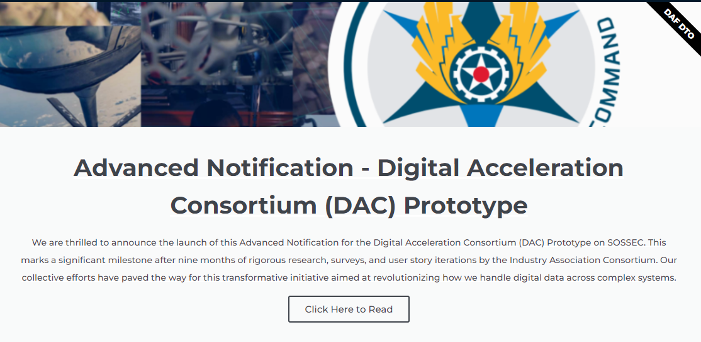
Digital Acceleration Consortium (DAC)
DAC Announcement
DAC Description
Approved for public release

Slide 13
Breakout #1: What Are We Changing To?
Approved for public release

Slide 14
Digital Materiel Management Language for System Engineering Technical Reviews
SAF/PA Cleared. Case Number: 2024-0936.

Slide 15
Background
Systems engineering technical reviews (SETRs)
Provide a venue to establish the technical baselines, assess the system’s technical maturity, and review and assess technical risks.
Use a list of criteria as laid out in the Systems Engineering Plan that is used to evaluate programmatic progress throughout the lifecycle.
The Department of the Air Force (DAF) wants to hold Programs accountable to digitally transform and embrace digital engineering
Independent Technical Risk Assessments (ITRAs) are one method the DAF is actively utilizing
By utilizing SETRs as well, the DAF can further understand if and how Programs are digitally transforming appropriately throughout the life cycle
The DAF has created digital engineering criteria at SETRs for expected digital engineering progress, but these criteria are in-development
SAF/PA Cleared. Case Number: 2024-0936.
Notes:
At each technical review, the PM will, to the extent practicable, use information from the digital authoritative source of truth to assess key risks, issues, opportunities, and mitigation plans in order to understand cost, schedule, and performance implications

Slide 16
The Need
These digital engineering gate criteria have never been used before to hold programs accountable
The DAF needs help solidifying the gate criteria and ensuring each criteria is at the correct SETR event and realistic
Please read the adjoining word document labeled “Digital SETR Gate Criteria” and provide feedback ahead of the workshop or be ready to provide feedback at the NDIA workshop
If unable to attend the workshop, there will be an opportunity to submit feedback closer to the start of the workshop virtually
The IAC will provide a link and instructions on how to submit virtual feedback
SAF/PA Cleared. Case Number: 2024-0936.

Slide 17
Systems Requirements Review Example Language
Contractor’s Systems Engineering Management Plan (SEMP) includes a comprehensive approach to digital engineering such as configuration management, model standards, style guides, tool usage, data management, key personnel/roles, company command media, modular open systems approach, and proprietary software/data.
The authoritative source of truth (ASoT) for program data is identified.
Programming languages and software architectures have been identified.
SAF/PA Cleared. Case Number: 2024-0936.

Slide 18
System Functional Review Example Language
SEMP accurately captures the digital engineering approach including digital thread structure and maintenance.
MBSE model contains the system verification methods and requirements.
MBSE model includes the system’s segments, elements, and major subsystems.
MBSE model includes the functional and performance requirements of the system’s segments, elements, and major subsystems traceable to the system requirements.
SAF/PA Cleared. Case Number: 2024-0936.

Slide 19
Preliminary Design Review Example Language
Program data is accessible to stakeholders through the digital engineering ecosystem.
The digital thread is developed in accordance with the SEMP.
MBSE model contains the segment, element, and subsystem verification methods and requirements.
MBSE model includes the system’s major components.
SAF/PA Cleared. Case Number: 2024-0936.

Slide 20
Critical Design Review Example Language
Program data is accessible to stakeholders through the digital engineering ecosystem.
The digital thread is developed in accordance with the SEMP.
MBSE model contains the component verification methods and requirements.
MBSE model includes the system’s components.
MBSE model includes the functional and performance requirements of the system’s components traceable to the system requirements.
SAF/PA Cleared. Case Number: 2024-0936.

Slide 21
Test Readiness Review Example Language
Artifacts supporting test readiness are accessible in the digital engineering ecosystem.
Models or simulations are in place to support test activities.
Plan to incorporate data from testing into models and simulations is complete.
SAF/PA Cleared. Case Number: 2024-0936.

Slide 22
System Verification Review Example Language
Artifacts that support verification of the functional and allocated baselines are stored in the digital engineering ecosystem.
Requirements were verified using the method described in the RVTM.
SAF/PA Cleared. Case Number: 2024-0936.

Slide 23
Production Readiness Review Example Language
Digital models have been updated with changes since TRR.
Production cost model is based on the stable detailed design and supply chain and has been validated using digital models.
Production planning is captured in digital models.
Models that will be used for production have been identified and are available.
Plan for digital engineering ecosystem sustainment through production is complete.
SAF/PA Cleared. Case Number: 2024-0936.

Slide 24
Physical Configuration Audit Example Language
Drawings, models, specifications, and other data items that are used for the PCA are accessible in the digital engineering ecosystem.
Digital models have been updated since PRR.
Plan to update models with findings from the PCA are complete.
SAF/PA Cleared. Case Number: 2024-0936.

Slide 25
Facilitated Exercise #1
Approved for public release

Slide 26
Facilitated Exercise #1 Part 1: Implementing Digital SETRs (25 Minutes)
For SETR processes in general, please use the space below to answer the following questions. If continuing your answers on a different page, please use the question number, e.g. 1.c, to indicate what you are responding to.
What are the overall challenges to preparing, documenting, executing, and reviewing SETRs?
What approaches (digital or otherwise) have you found successful in accelerating the SETR process while increasing (or maintaining) the efficacy of the review?
What digital tools, platforms, or methods have you used in your SETR processes? Have these been sufficient? Expand on successes, failures or gaps.
What are the lessons learned from the approaches you've tried or participated in?
What specific cultural attributes need to change to successfully implement the approaches identified above? Are their risks or impediments, and how would you mitigate or overcome them?
Approved for public release

Slide 27
Facilitated Exercise #1 Part 2: Implementing Digital SETRs (25 Minutes)
For your designated SETR event, please use the space below to answer the following questions. If continuing your answers on a different page, please use the question number, e.g. 1.c, to indicate what you are responding to.
For the Digital Engineering criteria proposed for your selected SETR event in the provided “Digital SETR Gate Criteria” document,
Do the listed digital engineering criteria make sense for your selected SETR event?
Are there any criteria you would add, change, or remove? (Annotate the Gate Criteria doc if helpful)
Do the listed criteria represent a reasonable digital maturity for the SETR event?
Approved for public release

Slide 28
Wrap Up/Admin (5 Minutes)
Like what you see? Fill this out to stay in touch with us!
Please conclude all work on the first facilitated discussion.
After the 15 minute break, we will be working on a new activity, focusing on an unencumbered future state of Digital SETRs. Please come back ready to discuss what the future would look like, if all barriers were removed.
Approved for public release

Slide 29
Facilitated Exercise #2
Approved for public release

Slide 30
Tasking #2: Future State
It is now 2045 and AFMC has actualized DMM – integrated federated ecosystem to include enterprise tools and data platforms. All policy and guidance has been updated to enable, encourage and enforce maximizing the usage of DMM
Approved for public release

Slide 31
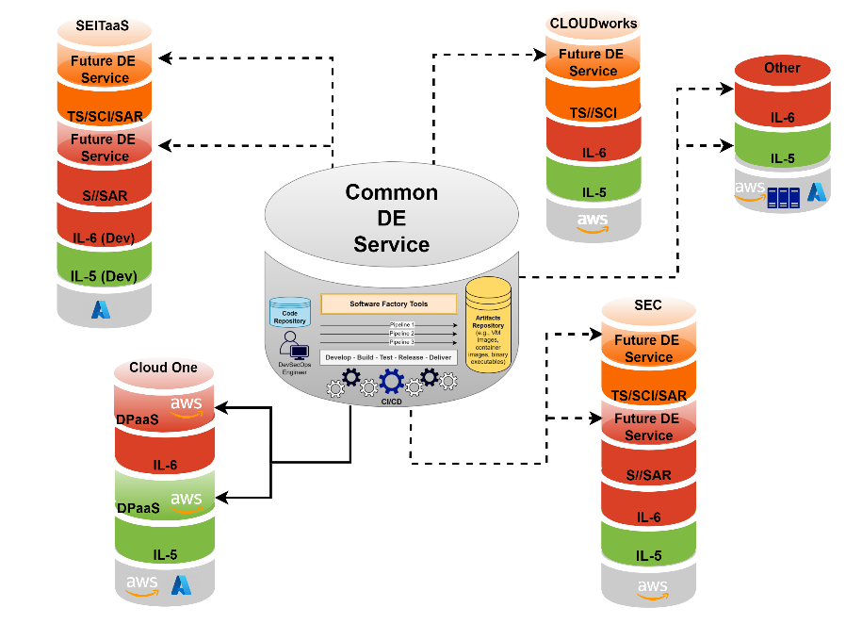
Tasking #2: Future State
Culture has been designed to adopt DMM
Workforce has been trained to operate in shared DMM environments and use DMM tools, such as CAD and PLM
DMM has been fully funded and is supported by all levels of leadership
DMM tools are available across the enterprise and can interoperate with each other
There is a data governance schema and enterprise data platforms that all tools can access as the ASoT
There is a shared environment that both government and industry can access with the appropriate guardrails for IP and Data Rights
Source: https://parkar.digital/understanding-digital-engineering-ecosystem-a-comprehensive-guide-2024/
Approved for public release

Slide 32
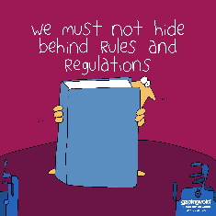
Facilitated Exercise #2: Imagining the Future of Technical Reviews (50 Minutes)
We live in an actualized DMM world but are doing SETRs the old way …
Do we continue to execute technical reviews through a digital process?
Do we burn it to the ground?
If so, then how do we meet the intent of what the technical Reviews are?
Or is there a middle ground?
1. How would you change / eliminate / redesign technical reviews in this new world?
2. Map out the new technical review process to make it a reality
Approved for public release

Slide 33
Facilitated Out-Brief (2 Minutes Per Table)

Slide 34
Closing Remarks
Approved for public release

Slide 35
Next Steps
AIAA SciTech Forum and Exposition in Orlando:
2025 forum theme is "Energize the Future"
January 6th -10th, 2025
Next DMM Workshop: January 8th
SciTech Website
Approved for public release

Slide 36
Mentimeter
Approved for public release

Slide 37
Stay Connected!
Approved for public release

Slide 38
DMM TEAM
Digital Materiel Management
Ensure critical processes employ digital methods across the entire lifecycle – from invention to retirement – for both warfighting capabilities as well as installation and mission support capabilities
Approved for public release

Slide 39
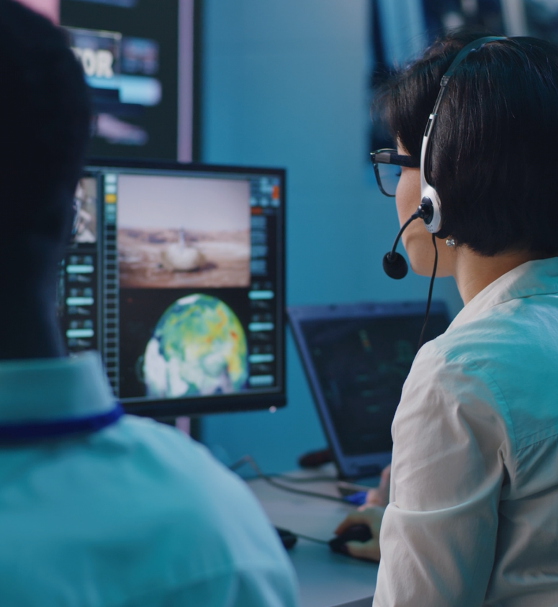
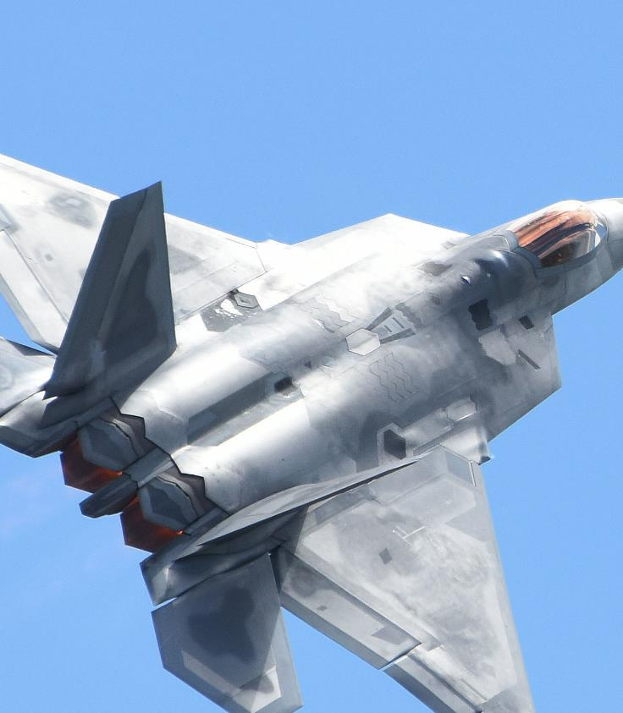
MISSION
Empower our workforce to adopt digital-first practices that accelerate materiel management
VISION
Enable the acquisition
Enterprise to deliver
Superior capabilities at
The speed of relevance
Approved for public release

Slide 40
Approved for public release

Slide 41
GUIDING FRAMEWORK
INSTILL A DIGITAL FIRST CULTURE
make a cultural shift to collaboration versus review, as DMM capabilities provide real-time interaction between government and industry
DEVELOP DIGITAL STRATEGIES
ensure programs and organizations share a common vision of applying digital-first strategies to their work across all functional disciplines
STRUCTURE AND SECURE OUR DATA
deploy data standards, formats, and reference architectures for MAJCOM lifecycle use
PROVIDE ACCESS TO DMM TOOLS
provide access to PLM tools, system and process modeling tools, design tools, and analytics tools across all functional disciplines
TRAIN OUR DIGITAL WORKFORCE
train the workforce to use and understand the power of DMM tools
MODERNIZE IT INFRASTRUCTURE
upgrade IT infrastructure (characterized by speed, agility, connectivity, and accessibility) to set the foundation for DMM progress across the MAJCOM
Approved for public release

