Slide 1
Digital Airworthiness Team
August 2021
Steven Turek, Ph.D.
Technical Lead
Digital Transformation Office (DTO)
HQ AFMC/ENSZ, WPAFB, OH
steven.turek.1@us.af.mil

Slide 2
BLUF
Digital airworthiness certification is a key enabler to field the latest technologies faster than our adversaries, thus SAF/AQR DEEO and AF Digital Campaign made Digital Airworthiness an early focus
No single organization has the resources or authority to overhaul the airworthiness process, and no overarching construct exists for coordinating, communicating, or prioritizing disparate efforts
A Digital Airworthiness Team is the mechanism to coordinate and communicate ongoing activities; provide strategic vision/direction on the implementation of digital methods, processes, and tools; and provide prioritized guidance and recommendations on current and future efforts
The Digital Airworthiness Team has received continued endorsement & input from the Air Force Airworthiness Management Steering Group (AMSG) & AF Airworthiness Office (AFLCMC/EZZ)
Formal kick‐off (50+ participants) and AA&S conference engaged stakeholders to increase awareness, explain the Team’s approach, and request participation in upcoming workshops that will focus on Problem Deconstruction; Future State Ideation; and Action, Prioritization, and Development

Slide 3
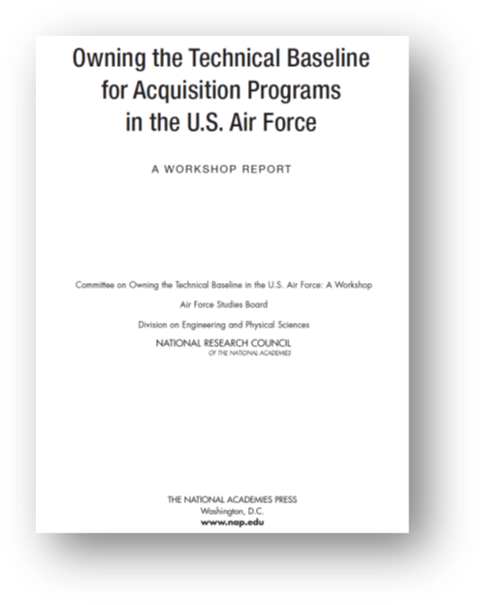
‘Digital’ Motivation and Strategic Guidance
Owning the Technical Baseline workshop report (2015)
OSD Digital Engineering Strategy (2018)
AF Digital Campaign (2020)
  Influence IT investments to enable a robust, secure infrastructure
  Provide an Integrated Digital Environment for collaboration, analysis, and visualization across functional domains of AF users
  Guide the use of Government Reference Architectures and related standards and datasets for enterprise and system-level application
  Develop Life Cycle Strategies and Processes for Technology Transition, System Acquisition and Product Support
  Assess and define the required policy and guidance changes to enable full implementation of the Digital Transformation
  Drive culture change through training and change management
SAF/AQ Vision
  There is No Spoon: Digital Acquisition (2020)
  Bending the Spoon: Guidebook for DE and e-Series (2021)
  Digital Building Codes (2021)

Slide 4
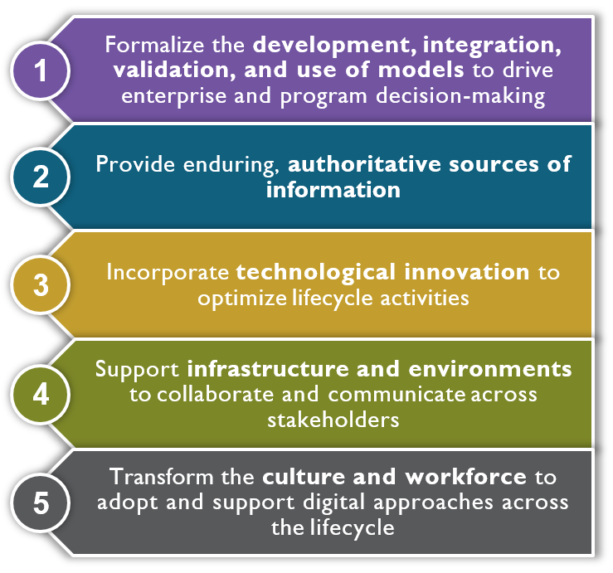
Digital Transformation
Office Vision & Goals
Vision: A digitally-empowered DAF equipped with an agile workforce, state-of-the-art technologies, and intuitive processes that drive model-based enterprise decision-making, enable automation, institutionalize open architectures, and leverage authoritative models and data to ensure seamless stakeholder collaboration across the lifecycle.
Notes:
DoD Digital Engineering Strategy: https://fas.org/man/eprint/digeng-2018.pdf
There is no Spoon: https://software.af.mil/wp-content/uploads/2020/10/There-Is-No-Spoon-Digital-Acquisition-7-Oct-2020-digital-version.pdf
Bending the Spoon: https://www.af.mil/Portals/1/documents/2021SAF/01_Jan/Bending_the_Spoon.pdf
Digital Building Code: https://software.af.mil/wp-content/uploads/2021/05/Digital-Building-Code-and-Scorecard-Memo-v15.pdf
Owning the Technical Baseline:

Slide 5
Digital Airworthiness Team
Digital technologies and practices are changing the landscape – we need to stay in sync across the AF and with industry partners
Digital Transformation enables enhanced decision-making
  Right data, to the right people, at the right time
  Effective collaboration
  Speed with rigor, efficiency gains
  Must understand uncertainty & risks
Need for a Digital Airworthiness Team
  Established a Digital Airworthiness Team to explore overlap between Digital and Airworthiness communities
  Intend to embrace agile development principles – start small, learn fast, customer engagement, create MVPs, etc.
  Plan to identify common challenges and strategic opportunities to address pervasive needs, and then prioritize with AMSG
  Methodical, facilitated approach...

Slide 6
Approach
Contract Airworthiness SMEs to gather and synthesize information regarding airworthiness policy, standards, and guidance; current state of the art/state of practice; create an ‘Airworthiness 101’ briefing
Create and synthesize recent success stories and lessons learned from prior digital transformation activities; ongoing digital transformation activities; and opportunities, gaps, and challenges
Engage Wright Brothers Institute to assemble and facilitate stakeholder workshops
  Jun‐Sep 2021: Problem Deconstruction (8‐10 mini‐workshops)
  Sep‐Oct 2021: Future State Ideation (4‐5 mini‐workshops)
  Oct‐Nov 2021: Action Ideation, Prioritization, Development (1 workshop & follow‐up activities)
Report summarizing the findings, including recommended strategic and tactical next steps
Construct detailed roadmap covering 1‐5 years which addresses the identified opportunities, gaps, and challenges; present to AMSG and incorporate feedback
Continuously communicate progress of ongoing digital airworthiness activities and interim/final results; engage with industry through workshops, professional societies, industry groups, and conferences

Slide 7
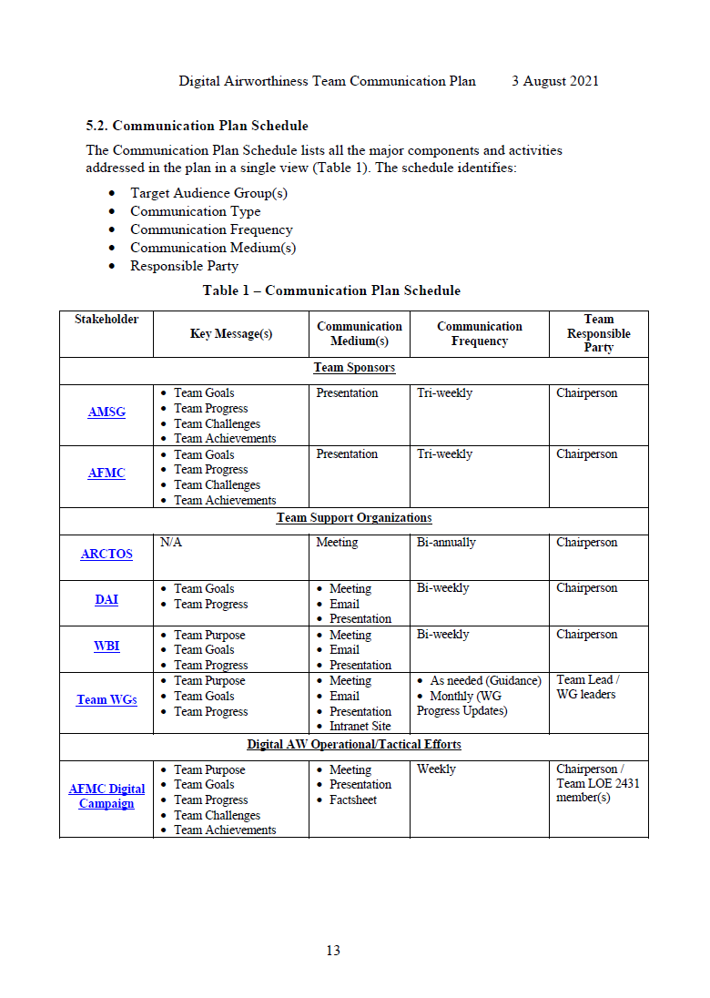
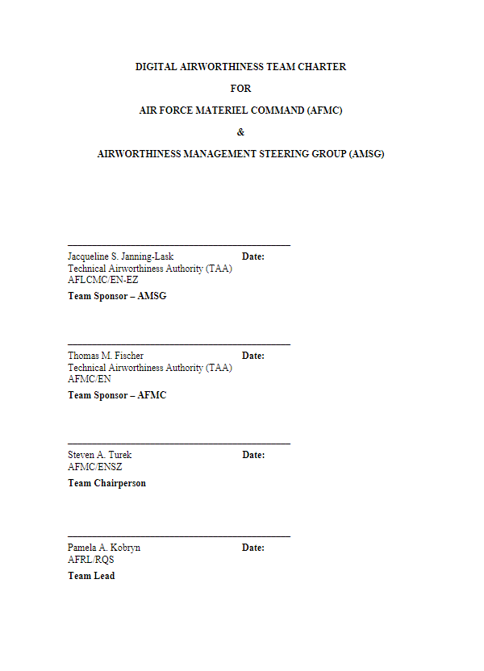
Charter & Comm Plans
Charter specifies
  Purpose, vision, work products, milestones, organization (sponsors, membership, responsibilities, etc.), Working Group roles & responsibilities, operating procedures
Communications Plan specifies
  Key messages, communication mediums, stakeholder groups & schedule

Slide 8
Initial Milestones
AF Digital Airworthiness vision approved by the AMSG
Team charter endorsed by:
  Mr. Thomas M. Fischer, SES (Technical Airworthiness Authority, Director of Engineering and Technical Management and Chief Engineer, Air Force Materiel Command); and
  Ms. Jacqueline S. Janning‐Lask, SES (Technical Airworthiness Authority, Director of Engineering and Technical Management and Chief Engineer, Air Force Life Cycle Management Center)
Strategic and Communication Plans approved by key stakeholders
Synthesized results from the five stakeholder group workshops
  EN-EZ & AW Offices
  Program Offices
  DOE/CE/DTAs
  Non-traditional (e.g. AFRL, AFTC, AFWERX, etc.)
  Industry
5‐year technology development/deployment roadmap approved by the AMSG

Slide 9








Digital AW Team Schedule (CY21)
 | Mar | Apr | May | Jun | Jul | Aug | Sep | Oct | Nov | Dec
Digital AW Team Standup & Kickoff
1
6
7
Problem Deconstruction Workshops
2
Future State
Ideation Workshops
3
Strategic Plan & Roadmap Development
4
5
Tech Sprint for Pilot Project
Pilot Project Execution
8
Steady-state Team Operations
  Kickoff Meeting
  List of challenges
  AF Digital Airworthiness Vision approved by the AMSG
  Strategic Plans approved by key stakeholders
  AMSG approved Technology & Process Development Roadmap
  Communication Plans approved by key stakeholders
  Team charter signed & Working Group charter template complete
  Demo of pilot project from the Technology Development Roadmap

Slide 10
Workshop Progress
Host stakeholder specific workshops across AF and industry
  EN-EZ & AW Offices
  Program Offices
  DOE/CE/DTAs
  Non-traditional (e.g. AFRL, AFTC, AFWERX, etc.)
  Industry
Focus
  Identify the current challenges for AW success and impediments to address
  Prioritize areas of attention
  Facilitate conversations to strategize
  Create roadmaps to various strategies
PH 1
PH 2

Slide 11
Preliminary Challenges from Home Office Group
Update 516; difficult to “put it on contract”
Translate AW criteria into system specification/verification/artifacts
Develop expertise in additional disciplines (training by criteria/process)
Address Developmental/Operational Risk within Safety
Improve Program Office Requirements Tool – move towards COTS software
Stop Project from moving forward if not ready; Holding program accountable for following the AW process
Moving back towards engineering, as opposed to risk management (managing risk of non-compliance)
Availability of data before entering AW process
Overall complexity of the process and overall depth/breadth of expertise involved
Generate a Real Time AW project tracker, know where to get daily updates
Get home office involved earlier and throughout program
Initial Take – Emphasis Areas:
Getting AW requirements/considerations into design, not separate (process)
Data availability (data) & expertise to review/interpret it
Shift focus from managing risk of non-compliance to program accountability

Slide 12
Preliminary Challenges from Program Office Groups
516 update/revision: need requirement /spec language; interpretation /application is inconsistent; need standards, objective measures throughout HDBK​
Workforce management competency/training: need training for other functionals/ contractors/ process changes/ data systems/ SE big picture and better tailoring for audience​
Data rights/availability/access/storage/CM/digital thread/security/workload burden​
Culture: overly conservative / AW treated as separate process​
Up front prep/planning/contract incorporation and full program integration​
Internal Processes: AW tools and execution inconsistent from program to program​
External Processes: guidance and template change tempo, process, and communication / large documentation burden for small and administrative changes / no good way to assess “risk burn down” in advance​
Roles / Authorities: Endorsements not useful or​ consistent across sections​
ACT: rigid/restrictive/segregated/limited/hard to use​
Insufficient resources: people/$/schedule​
Process overlap/conflict – System Safety​
Initial Take – Emphasis Areas: ​
Digital thread (MBSE, DE, PLM, artifacts, etc.)​
Ready access to information for all stakeholders​ (data)
Reduce manual data workload​ & increase consistency of application (516 revision)
Getting AW requirements/considerations into design (process) ​
Workforce/competency development​

Slide 13
Preliminary Challenges from DOE/CE/DTA Group
Subjectivity in risk assessment philosophy
Inconsistent application of 516 (intent vs strict interpretation – personalities dominate process)
Need better access to contractor data
Keeping everyone current on process and policy
Raising education/competency level of players at many levels
Unclear industry incentives – interpretation of the contract is an issue
Tools are inadequate or non-existent; lack of requirements tool use, Excel still used
Staffing is less than needed
Design requirements and 516 criteria are not aligned or correlated
Initial Take – Emphasis Areas:
Improve use of tools and tool capability – “too rigid and restrictive”
Reconciling overlap of AW risks and safety risks
Data availability (data)
Bake-in what compliance means, so contract is explicit (process)
Consistent in processes and application of 516 (revision)
Notes:
DTA = Delegated Technical Authorities

Slide 14
Core Team & Contracted SMEs
Core Team Members:
  Dr. Turek, HQ AFMC/ENSZ (Technical Lead)
  Dr. Kobryn, AFRL/RQS (AFRL Digital SME)
  Mr. Kutter, SL, AFLCMC/EN‐EZ (Technical Advisor)
  Mr. Baker, AFLCMC/WL (Director of Engineering)
  Mr. Falcone, AFLCMC/HB (Director of Engineering)
  Ms. Lohn, AFLCMC/WAQ (Lead Flight Sys Engineer)
  Ms. Janszen, AFLCMC/EZZ (AW Technical Expert)
  Mr. Dillsaver, AFLCMC/EZZ (UAS Technical Expert)
  Mr. Demerly, AFLCMC/WAQ (Airworthiness Lead)
ARCTOS:
  Dr. Rollie Dutton
Dayton Aero SMEs:
  Ms. Dawn McGarvey-Buchwalder
  Ms. Betty Rodriguez
  Mr. Bob Stanton

Slide 15
Questions?

Slide 16


